Slide 1
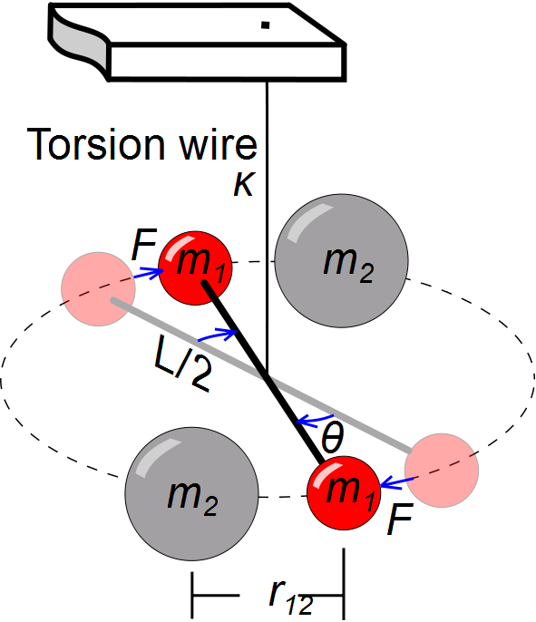

Slide 2
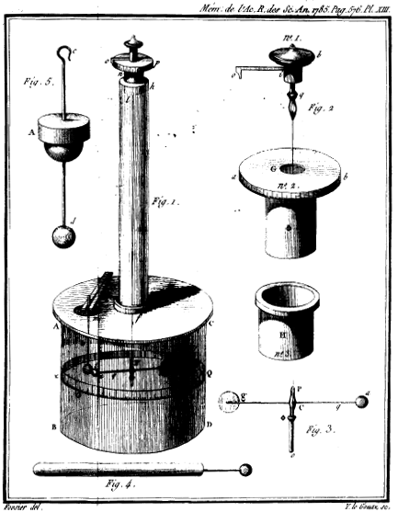

Slide 3
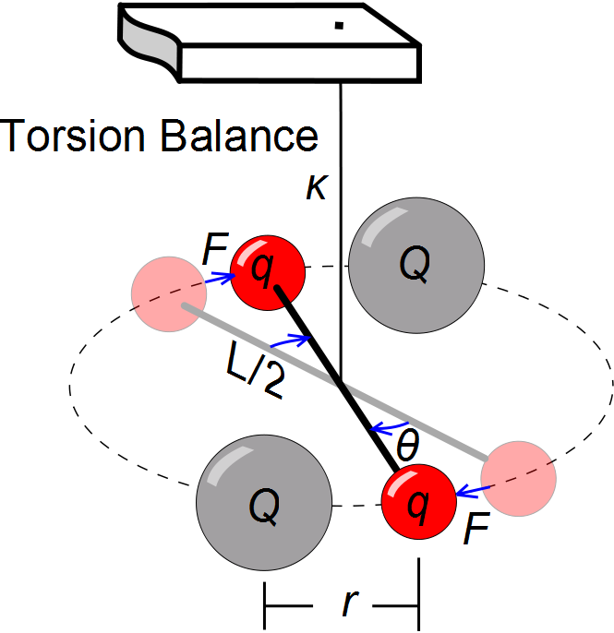

Slide 4
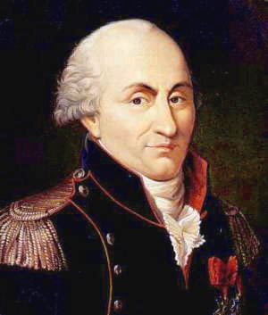
Charles Coulomb
1736 – 1806
Studied electrostatics and magnetism

Slide 6
Calculate the magnitude of the electric force between the proton and electron in a hydrogen atom.
Compare to their gravitational attraction.

Slide 7
Coulomb Force
q₂
+
F₂₁
F₁₂
r
-
q₁

Slide 8
Coulomb Force
q₂
F₂₁
+
r
+
q₁
F₁₂

Slide 9
Coulomb Force
q₂
F₂₁
-
r
-
q₁
F₁₂

Slide 10
Characteristics of Particles
Electron
Charge -1.60 x 10⁻¹⁹ C
Mass 9.11 x 10⁻³¹ Kg
Proton
Charge +1.60 x 10⁻¹⁹ C
Mass 1.67 x 10⁻²⁷ Kg

Slide 11
Analogy with Gravity
F_{SR}
F_{RS}
Earth
Rexburg Rock

Slide 12
Analogy with Gravity
F_{SR}
F_{RS}
Rexburg Rock
China Rock

Slide 13
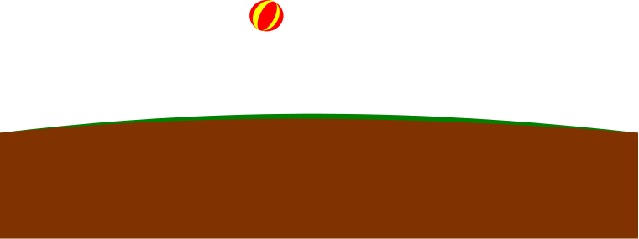
a
m
v
M_{E}

Slide 14

E
q_{o}
v
Q

Slide 16
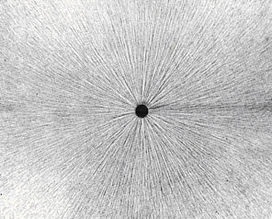
Field Lines
http://stargazers.gsfc.nasa.gov/images/geospace_images/electricity/elec_field_lines.jpg

Slide 17
Field Lines
http://stargazers.gsfc.nasa.gov/images/geospace_images/electricity/elec_field_lines.jpg

Slide 19
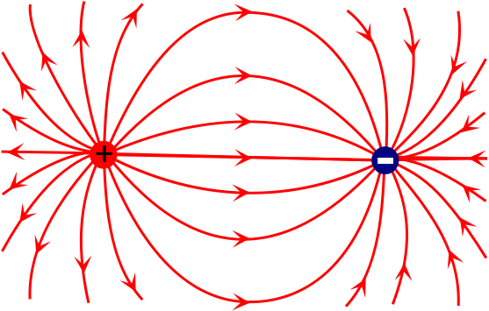
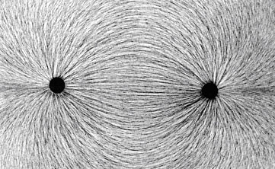
Field Lines
http://stargazers.gsfc.nasa.gov/images/geospace_images/electricity/elec_field_lines2.jpg

Slide 20
